Slide 1
The Circuit Less Travelled: A Path of Gentrification Through Colorado Neighborhoods
Weston Grewe and Angela Morrison

Slide 2
Motivation
What is gentrification?
“The process whereby the character of a poor urban area is changed by wealthier people moving in, improving housing, and attracting new businesses, typically displacing current inhabitants in the process.”
What impact does it have on our neighborhoods?
Schools
Home prices
Quality of life
What policy changes can we make to reduce these negative effects?
Prohibit large scale development
Reduce/freeze property taxes for long-term residents

Slide 3
The Data
5-year period aggregate survey data at the neighborhood level for the state of Colorado (2006-2010,2010-2015,2015-2019)
Columns related to gentrification:
Average income
Highest level of education
Demographic breakdown
Something to keep in mind: these variables all use different scales for their values

Slide 4
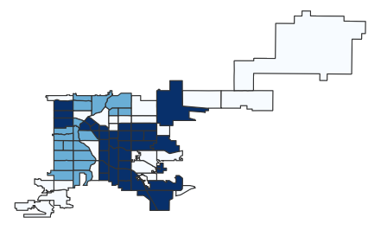
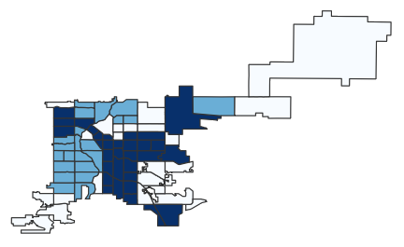
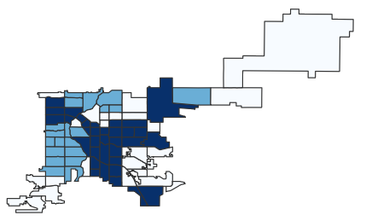
K-Means Clustering
2006
2010
2015

Slide 5
Describing the Clusters
2006
 | Cluster 1 | Cluster 2 | Cluster 3
Med Income | 54,000 | 27,000 | 15,000
% White | 79 | 53 | 21
% Hispanic | 8 | 26 | 66
% Black | 4 | 14 | 7
% College | 65 | 37 | 14
% Poverty | 4 | 15 | 29

Slide 6
What do the Circuits Mean?
Start
Step 1
Step 2
End
We get an idea of where people are moving.
For us, we are looking at which of the lower privilege neighborhoods are being impacted
Example:

Slide 7
Implementing the Algorithms
Getting the Circuits:
Build graph
Depth First Search
Pull out only cycles and sequential paths
Turn them in the correct form for circuits
Programming the Circuit Walk:
Test for sign compatibility
Determine if circuit has zeros in at least as many of the same spots as the difference vector
Append to walk
No need to check for lambda

Slide 8
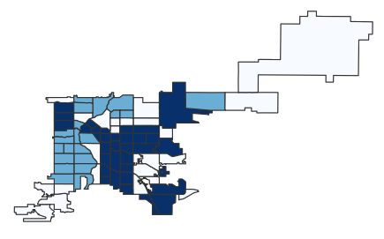

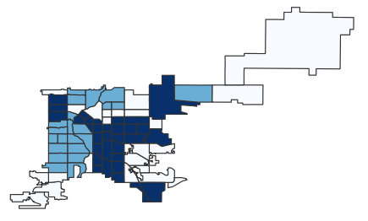
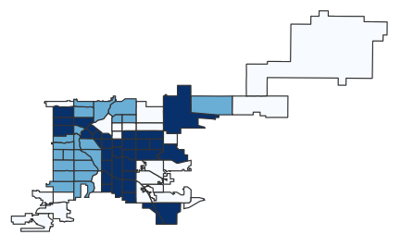

2006 to 2010 Circuit Walk
Start
Step 1
Step 2
Step 3
Step 4
End

Slide 9
Including Geographic Information
Choosing Our Circuits Wisely:
Compute distance matrix for neighborhoods in Denver
Order the circuits based on this distance matrix
Circuits are higher in the list if they are used to move neighborhoods that are geographically close to one another
Circuits that just do one swap are sent to the bottom of the list
Send through circuit walk algorithm

Slide 10
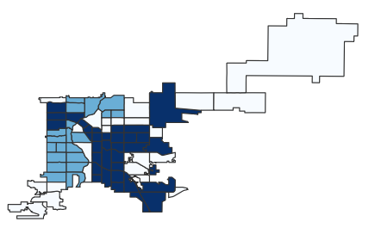
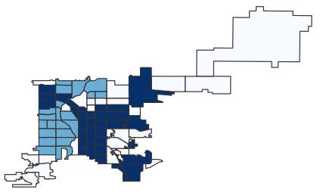
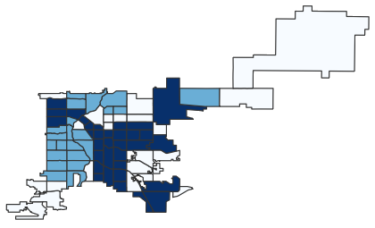

2006 to 2010 Circuit Walk with Geographic Data
Start
Step 1
Step 2
Step 3
End

Slide 11
References
D. P. 7 policies that could prevent gentrification. Shelterforce. (2021, October 18) Retrieved November 9, 2021, from https://shelterforce.org/2014/05/23/7_policies_that_could_prevent_gentrification/.
Displacement of lower-income families in urban areas report. (n.d.). Retrieved November 30, 2021, from https://www.huduser.gov/portal/sites/default/files/pdf/DisplacementReport.pdf.
Denver Open Data Catalog: American Community survey nbrhd (2006-2010). (n.d.). Retrieved November 9, 2021, from https://www.denvergov.org/opendata/dataset/city-and-county-of-denver-american-community-survey-nbrhd-2006-2010.
Denver Open Data Catalog: American Community survey NBRHD (2010-2014). (n.d.). Retrieved November 9, 2021, from https://www.denvergov.org/opendata/dataset/city-and-county-of-denver-american-community-survey-nbrhd-2010-2014.
Denver Open Data Catalog: American Community survey NBRHD (2015-2019). (n.d.). Retrieved November 9, 2021, from https://www.denvergov.org/opendata/dataset/american-community-survey-nbrhd-2015-2019.
Denver Open Data Catalog: Statistical neighborhoods. (n.d.). Retrieved November 9, 2021, from https://www.denvergov.org/opendata/dataset/city-and-county-of-denver-statistical-neighborhoods.

Slide 12



Questions?

